Slide 1
Satellite Communications
Look Angle Determination

Slide 2
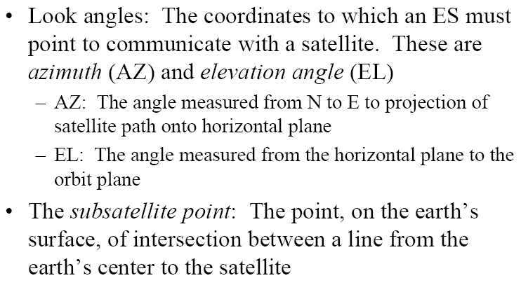
Look Angle Determination

Slide 3
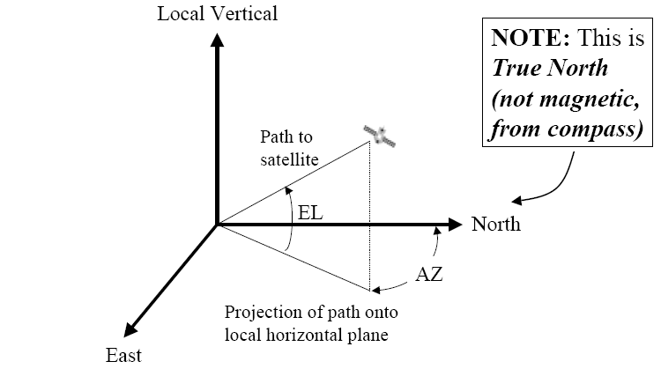
Look Angle Definition

Slide 4
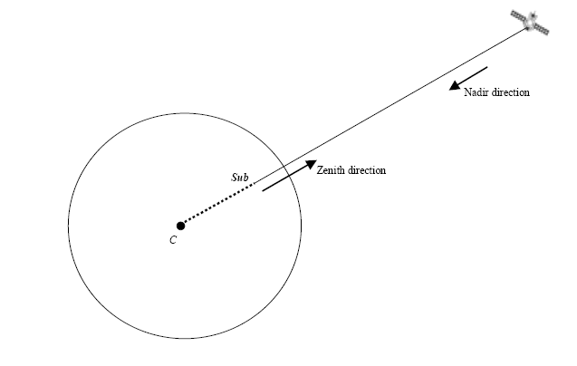
Definitions (Contd.)

Slide 5
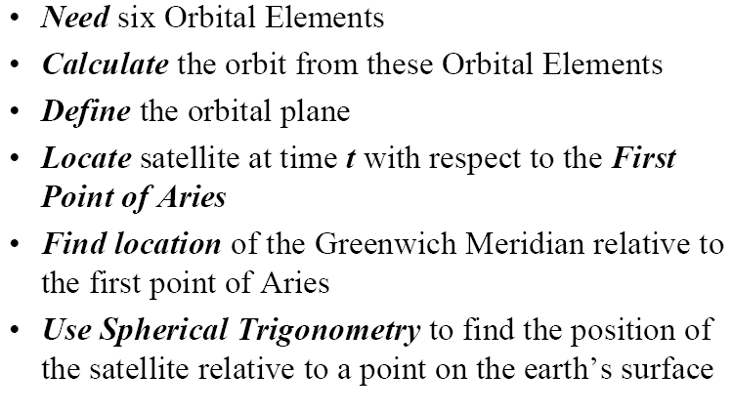
Calculating Look Angle

Slide 6
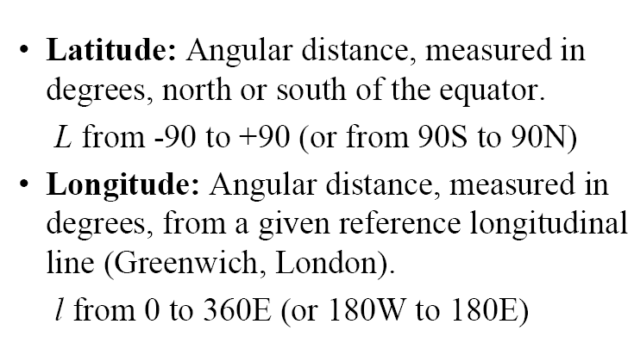
Coordinate System

Slide 7
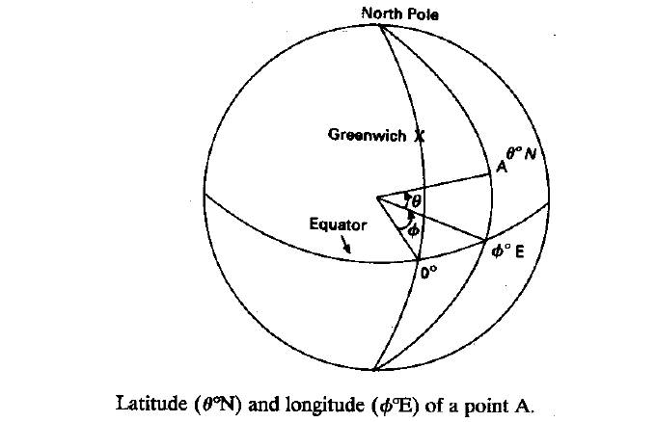
Coordinate System

Slide 8
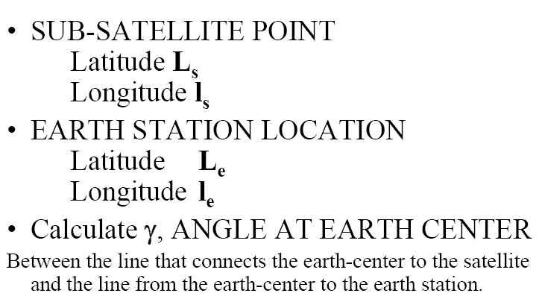
Satellite Coordinates

Slide 9
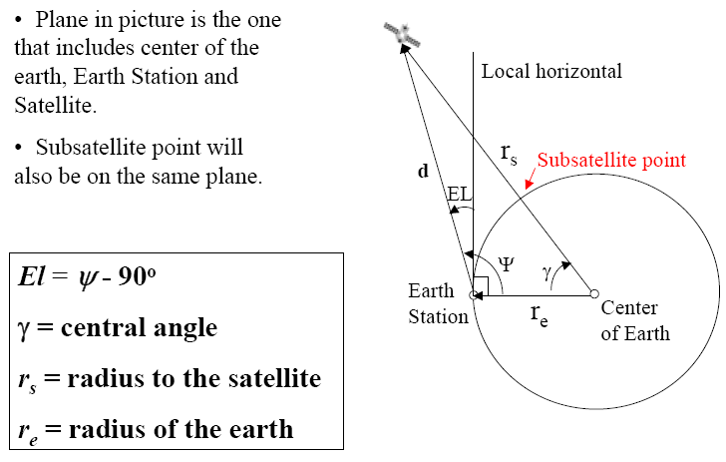
Geometry of Elevation Angle

Slide 10
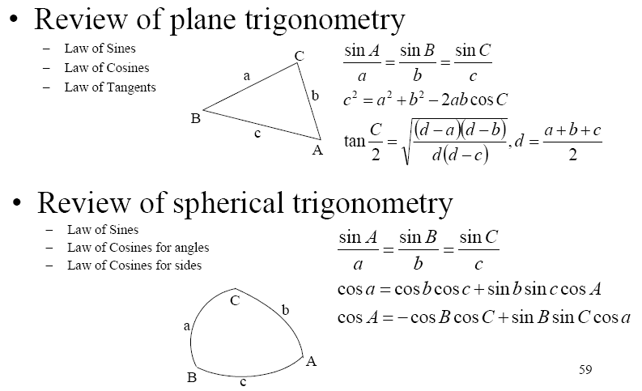
Review of Geometry

Slide 11
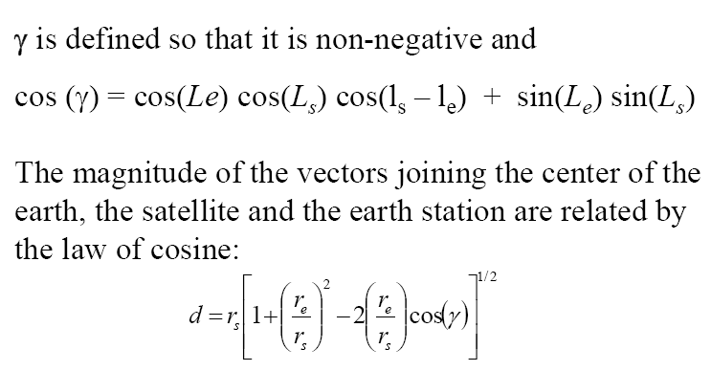
Central Angle

Slide 12
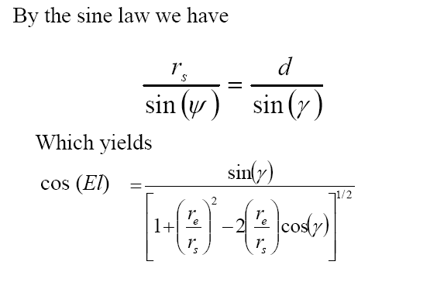
Elevation Angle Calculation

Slide 13
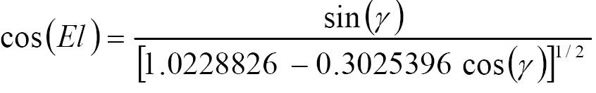
Example: Elevation Angle for GEO Satellite
Using rs = 42,164 km and re = 6,378.14 km gives
d = 42,164 [1.0228826 -0.3025396 cos(γ)]1/2 km
Which finally gives the elevation angle

Slide 14
Azimuth Angle Calculation
More complex approach for non-geo satellites.
Different formulas and corrections apply depending on the combination of positions of the earth station and subsatellite point with relation to each of the four quadrants (NW, NE, SW, SE).
Its calculation is simple for GEO satellites

Slide 15
Azimuth Angle Calculation for GEO Satellites
SUB-SATELLITE POINT
  Equatorial plane, Latitude Ls = 0o
  Longitude ls
EARTH STATION LOCATION
  Latitude Le
  Longitude le

Slide 16
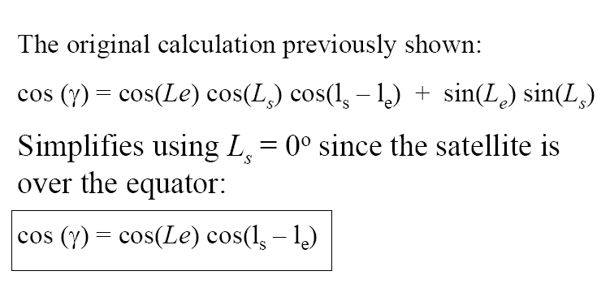
Azimuth Angle for GEO sat.

Slide 17
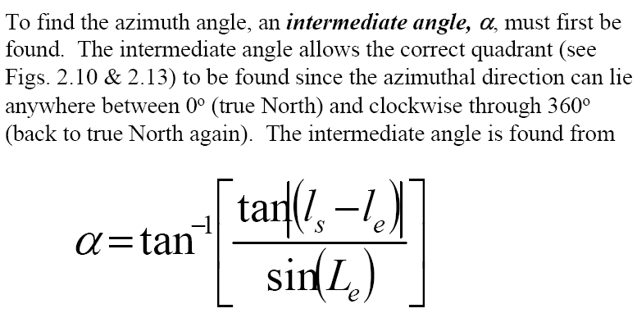
Azimuth Angle for GEO sat.

Slide 18
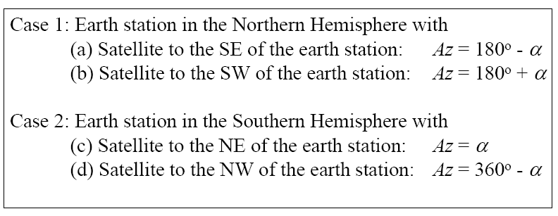
Azimuth Angle for GEO sat.

Slide 19
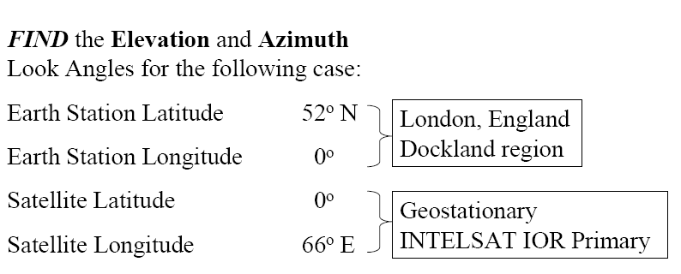
Example for Look Angle Calculation of a GEO satellite

Slide 20
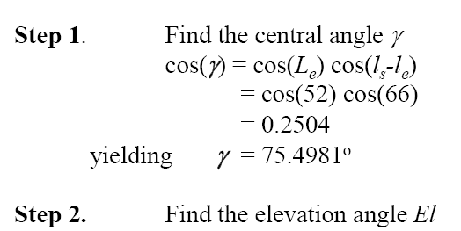
Example (Contd.)
El=5.85º

Slide 21
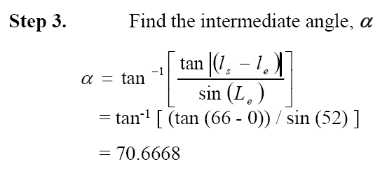
Example (Contd.)

Slide 22
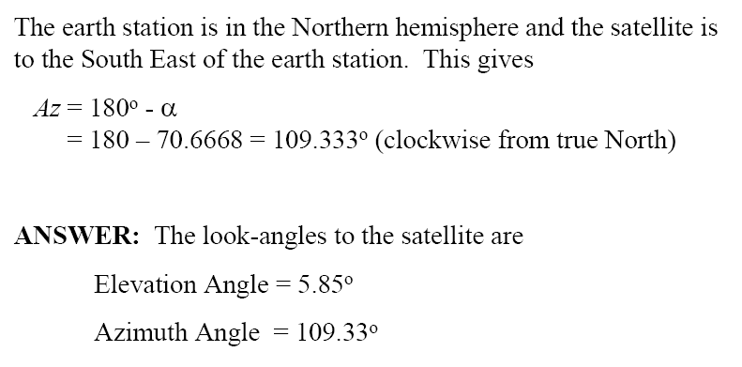
Example (Contd.)

